Slide 1
Introduction to Statistics

Slide 2
Statistics
The science of collectiong, organizing, presenting, analyzing, and interpreting data to assist in making more effective decisions
Statistical analysis – used to manipulate summarize, and investigate data, so that useful decision-making information results.

Slide 3
Types of statistics
Descriptive statistics – Methods of organizing, summarizing, and presenting data in an informative way
Inferential statistics – The methods used to determine something about a population on the basis of a sample
Population –The entire set of individuals or objects of interest or the measurements obtained from all individuals or objects of interest
Sample – A portion, or part, of the population of interest

Slide 4
Inferential Statistics
Estimation
e.g., Estimate the population mean weight using the sample mean weight
Hypothesis testing
e.g., Test the claim that the population mean weight is 70 kg
Inference is the process of drawing conclusions or making decisions about a population based on sample results

Slide 5
Population
The entire group of individuals is called the population.
For example, a researcher may be interested in the relation between class size (variable 1) and academic performance (variable 2) for the population of third-grade children.

Slide 6
Sample
Usually populations are so large that a researcher cannot examine the entire group. Therefore, a sample is selected to represent the population in a research study. The goal is to use the results obtained from the sample to help answer questions about the population.

Slide 7
Sampling
a sample should have the same characteristics
as the population it is representing.
Sampling can be:
with replacement: a member of the population may be chosen more than once (picking the candy from the bowl)
without replacement: a member of the population may be chosen only once (lottery ticket)

Slide 8
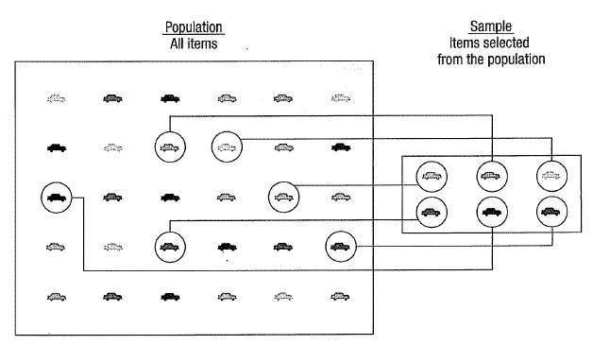

Slide 9
Sampling methods
Sampling methods can be:
random (each member of the population has an equal chance of being selected)
nonrandom
The actual process of sampling causes sampling
errors. For example, the sample may not be large
enough or representative of the population. Factors not
related to the sampling process cause nonsampling
errors. A defective counting device can cause a
nonsampling error.

Slide 10
Random sampling methods
simple random sample (each sample of the same size has an equal chance of being selected)
stratified sample (divide the population into groups called strata and then take a sample from each stratum)
cluster sample (divide the population into strata and then randomly select some of the strata. All the members from these strata are in the cluster sample.)
systematic sample (randomly select a starting point and take every n-th piece of data from a listing of the population)

Slide 11
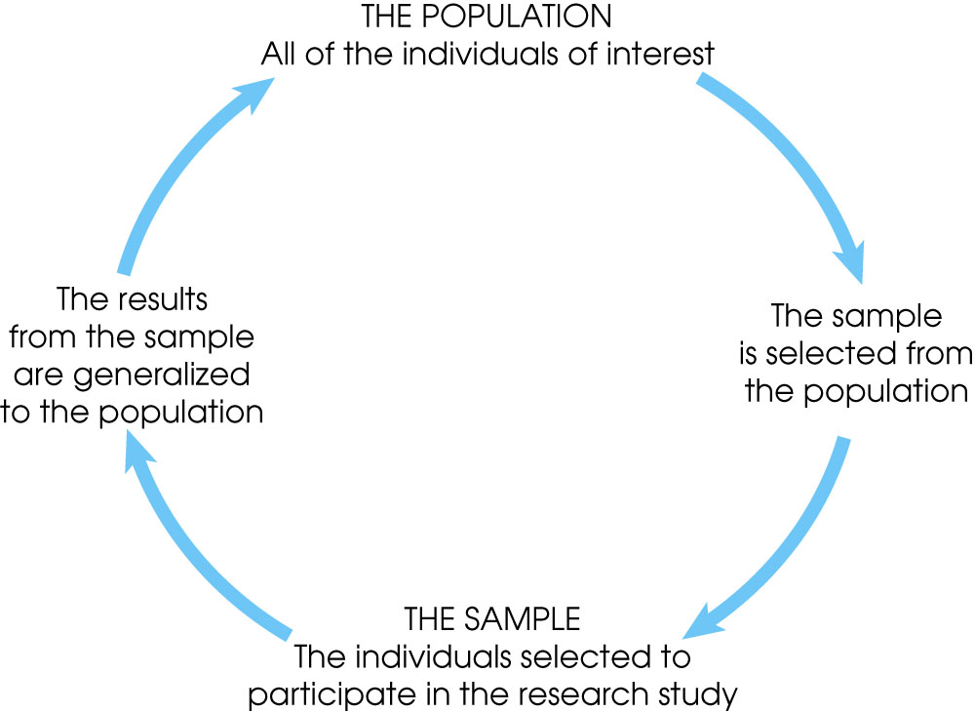
Notes:
Figure 1.1
The relationship between a population and a sample.

Slide 12
Sampling Error
The discrepancy between a sample statistic and its population parameter is called sampling error.
Defining and measuring sampling error is a large part of inferential statistics.

Slide 13
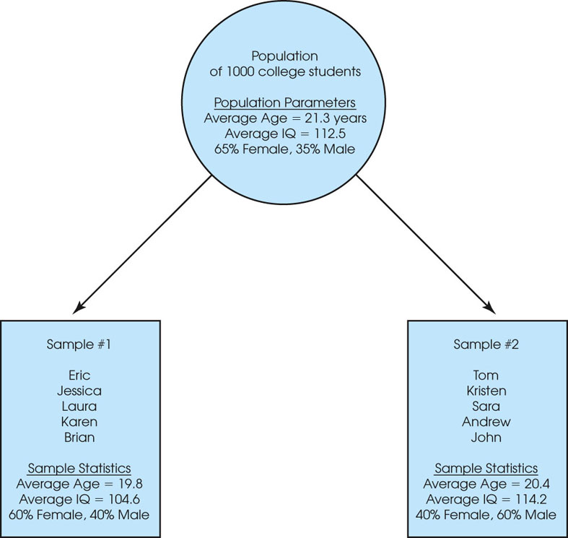
Notes:
Figure 1.2
A demonstration of sampling error. Two samples are selected from the same population. Notice that the sample statistics are different from one sample to another, and all of the sample statistics are different from the corresponding population parameters. The natural differences that exist, by chance, between a sample statistic and a population parameter are called sampling error.

Slide 14
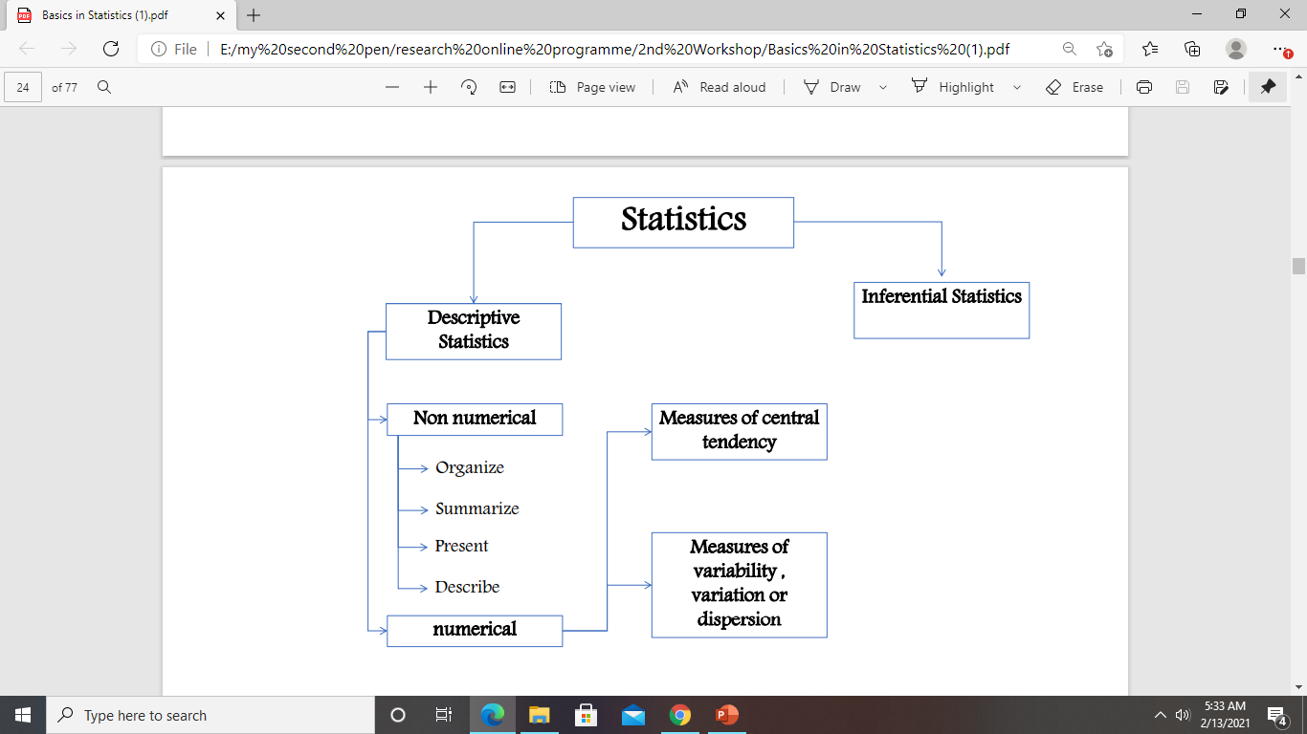

Slide 15
Descriptive Statistics
Descriptive statistics are methods for organizing and summarizing data.
For example, tables or graphs are used to organize data, and descriptive values such as the average score are used to summarize data.
A descriptive value for a population is called a parameter and a descriptive value for a sample is called a statistic.

Slide 16
Inferential Statistics
Inferential statistics are methods for using sample data to make general conclusions (inferences) about populations.
Because a sample is typically only a part of the whole population, sample data provide only limited information about the population. As a result, sample statistics are generally imperfect representatives of the corresponding population parameters.

Slide 17
Descriptive Statistics
Collect data
e.g., Survey
Present data
e.g., Tables and graphs
Summarize data
e.g., Sample mean =

Slide 18
Variables
A variable is a characteristic or condition that can change or take on different values.
Most research begins with a general question about the relationship between two variables for a specific group of individuals.

Slide 19
Types of Variables
Variables can be classified as discrete or continuous.
Discrete variables (such as class size) consist of indivisible categories, and continuous variables (such as time or weight) are infinitely divisible into whatever units a researcher may choose. For example, time can be measured to the nearest minute, second, half-second, etc.

Slide 20
Types of variables
Variables
Qualitative
Quantitative
Dichotomic
Polynomic
Discrete
Continuous
Gender, marital status
Brand of Pc, hair color
Children in family, Strokes on a golf hole
Amount of income tax paid, weight of a student

Slide 21
Measuring Variables
To establish relationships between variables, researchers must observe the variables and record their observations. This requires that the variables be measured.
The process of measuring a variable requires a set of categories called a scale of measurement and a process that classifies each individual into one category.

Slide 22
4 Types of Measurement Scales
A nominal scale is an unordered set of categories identified only by name. Nominal measurements only permit you to determine whether two individuals are the same or different.
Color: Red, Orange, Blue
An ordinal scale is an ordered set of categories. Ordinal measurements tell you the direction of difference between two individuals.
Grade: Excellent, v. good, good, fair, ….
Temp: High, medium, low
Freq: everyday, sometimes, never, …

Slide 23
4 Types of Measurement Scales
An interval scale is an ordered series of equal-sized categories. Interval measurements identify the direction and magnitude of a difference. The zero point is located arbitrarily on an interval scale.
Age: 16-20, 21-25, 26-30, …..
A ratio scale is an interval scale where a value of zero indicates none of the variable. Ratio measurements identify the direction and magnitude of differences and allow ratio comparisons of measurements.
Age: 65 ➔ 0.6
Income: 36,000 ➔ 0.33
Given: Age 17. Max: 70, min 13 ➔ (17 – min) / (max – min)

Slide 24
Correlational Studies
The goal of a correlational study is to determine whether there is a relationship between two variables and to describe the relationship.
A correlational study simply observes the two variables as they exist naturally.
Correlation coefficient
Range [-1, 1]
-1: negative correlation
+1: positive correlation
0: no relation

Slide 25
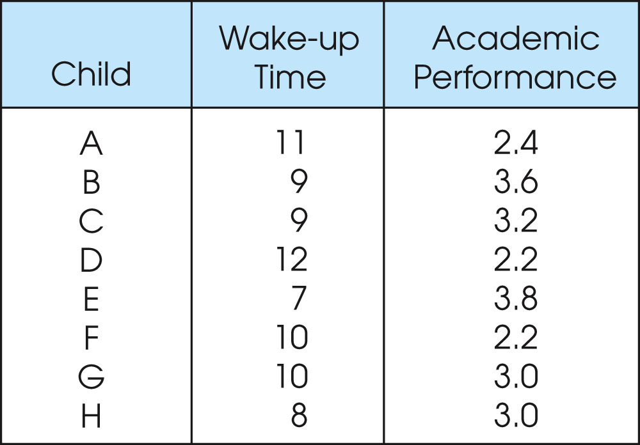
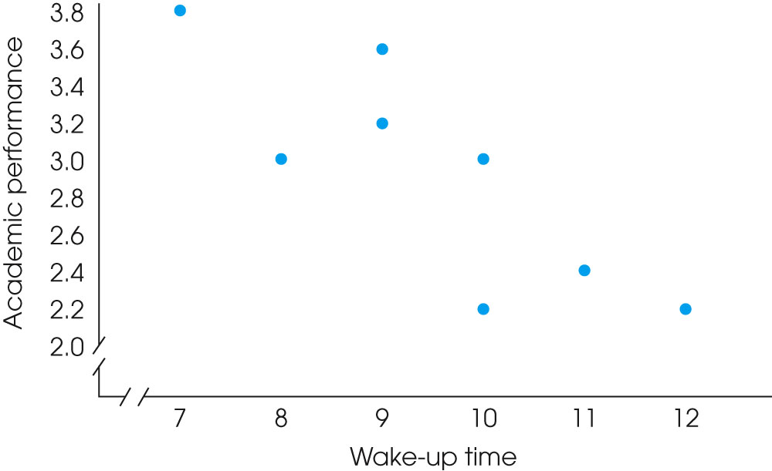
Notes:
Figure 1.4
One of two data structures for studies evaluating the relationship between variables. Note that there are two separate measurements for each individual (wake-up time and academic performance). The same scores are shown in a table (a) and in a graph (b).

Slide 26
Experiments
The goal of an experiment is to demonstrate a cause-and-effect relationship between two variables; that is, to show that changing the value of one variable causes changes to occur in a second variable.

Slide 27
Experiments (cont.)
In an experiment, one variable is manipulated to create treatment conditions. A second variable is observed and measured to obtain scores for a group of individuals in each of the treatment conditions. The measurements are then compared to see if there are differences between treatment conditions. All other variables are controlled to prevent them from influencing the results.
In an experiment, the manipulated variable is called the independent variable and the observed variable is the dependent variable.

Slide 28
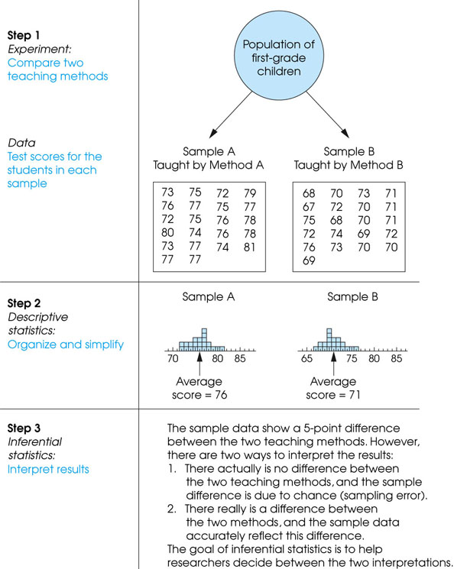
Notes:
Figure 1.3
The role of statistics in experimental research.

Slide 29
Other Types of Studies
Other types of research studies, know as non-experimental or quasi-experimental, are similar to experiments because they also compare groups of scores.
These studies do not use a manipulated variable to differentiate the groups. Instead, the variable that differentiates the groups is usually a pre-existing participant variable (such as male/female) or a time variable (such as before/after).

Slide 30
Other Types of Studies (cont.)
Because these studies do not use the manipulation and control of true experiments, they cannot demonstrate cause and effect relationships. As a result, they are similar to correlational research because they simply demonstrate and describe relationships.

Slide 31
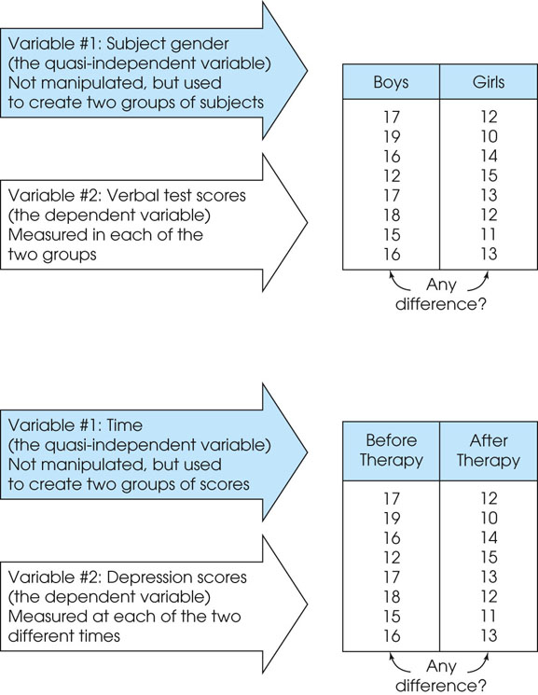
Notes:
Figure 1.7
Two examples of nonexperimental studies that involve comparing two groups of scores. In (a) the study uses two preexisting groups (boys/girls) and measures a dependent variable (verbal scores) in each group. In (b) the study uses time (before/after) to define the two groups and measures a dependent variable (depression) in each group.

Slide 32
Data
The measurements obtained in a research study are called the data.
The goal of statistics is to help researchers organize and interpret the data.

Slide 33
Data
Statistical data are usually obtained by counting or measuring items. Most data can be put into the following categories:
Qualitative - data are measurements that each fail into one of several categories. (hair color, ethnic groups and other attributes of the population)
quantitative - data are observations that are measured on a numerical scale (distance traveled to college, number of children in a family, etc.)

Slide 34
Thank you

